Slide 1
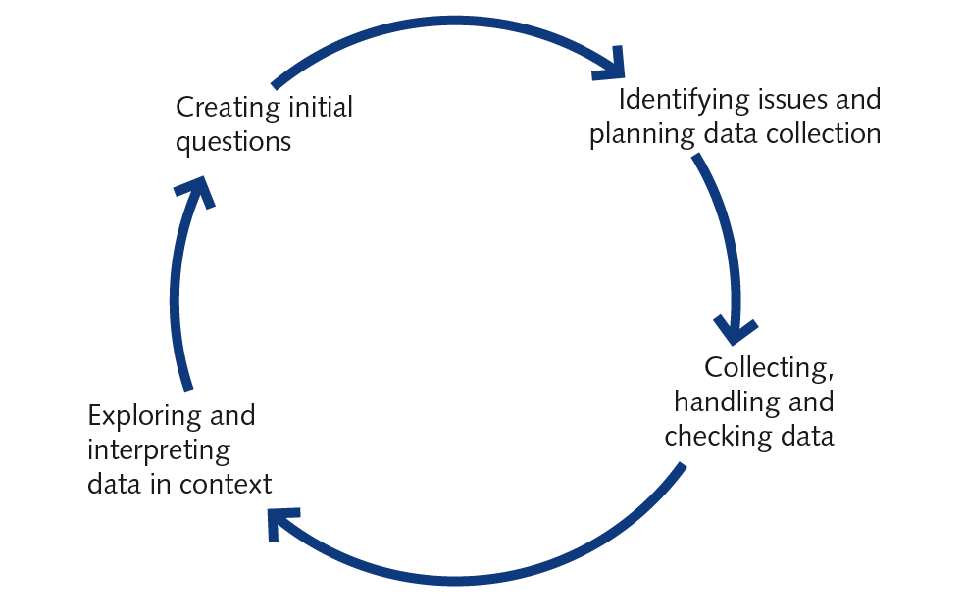
Statistics Investigation Process

